Slide 1
Yara International ASA Torgeir Kvidal, CFO
BofAML Conference
London 2 December 2013

Slide 2
Financial highlights
Strong results
Increase in deliveries from completion of Bunge acquisition
Declining commodity fertilizer prices but robust value-added product premiums
Improved production regularity
Record cash distribution
Notes:
Yara uses CROGI (Cash Return On Gross Investment) to measure the performance of its business. The goal is to maintain a CROGI at or above 10% as an average over the business cycle.
Measured on a 12-month rolling basis, CROGI remained well above 10% in 2013 and Yara’s balance sheet has strengthened substantially amid strong cash flow.

Slide 3
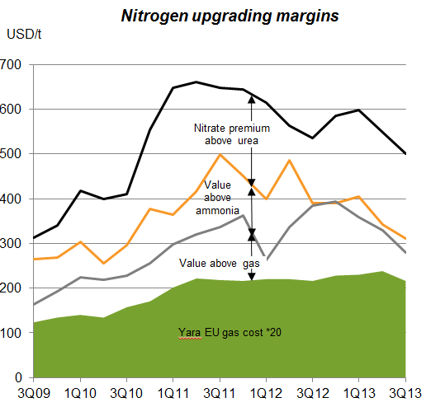
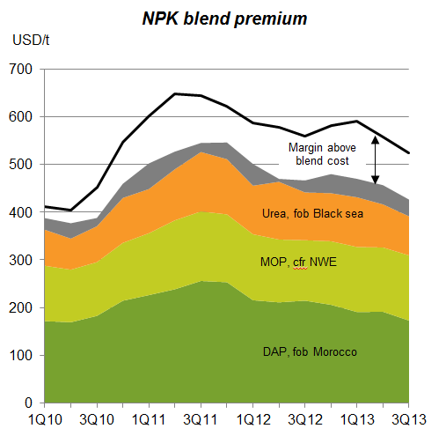
Value-added products deliver an increasing share of Yara’s contribution
NOK millions
Total Yara contribution
9,000
8,000
Trade
7,000
6,000
5,000
Upgrade & distribution
4,000
3,000
Commodity overseas
2,000
1,000
Commodity Europe
0
1Q10
3Q10
1Q11
3Q11
1Q12
3Q12
1Q13
3Q13
Notes:
The share of the contribution generated by European and overseas commodity business has decreased over the last year commodity prices in combination with limited upgrade margins from ammonia to urea/UAN. At the same time the value added share of the contribution has increased as we have been able to maintain a stable nitrate premium and NPK premium above blend. Contribution from trade activities has been stable during the same period.

Slide 4
Fertilizer portfolio is being driven towards greater product differentiation and profit
Product portfolio (2012/13 season volume)
Differentiation improves margins and reduces exposure to commodity price volatility
On-going efforts to further increase differentiation through:
Additional Nitrate+S and Urea+S
On-going optimization of NPK portfolio towards higher value segments
Innovation and market growth in high-value fertigation markets
Continued YaraVita growth
10%
35%
28%
26%
Standard products (Urea, UAN and Ammonia)
Differentiated products (CAN, AN)
Specialty (CN, Compound NPK, Fertigation)
NPK blends
Notes:
Currently more than 50% of Yara’s portfolio consist of differentiated and specialty products. Pure urea accounts for approximately 25% of sales volume. Yara combines leading marketing, agronomical knowhow and innovation competence to achieve value-added premiums and sustainable market positions.
Prices and margins for non-standard products are relatively uncorrelated to commodity fertilizer prices, and more strongly linked to food prices.

Slide 5
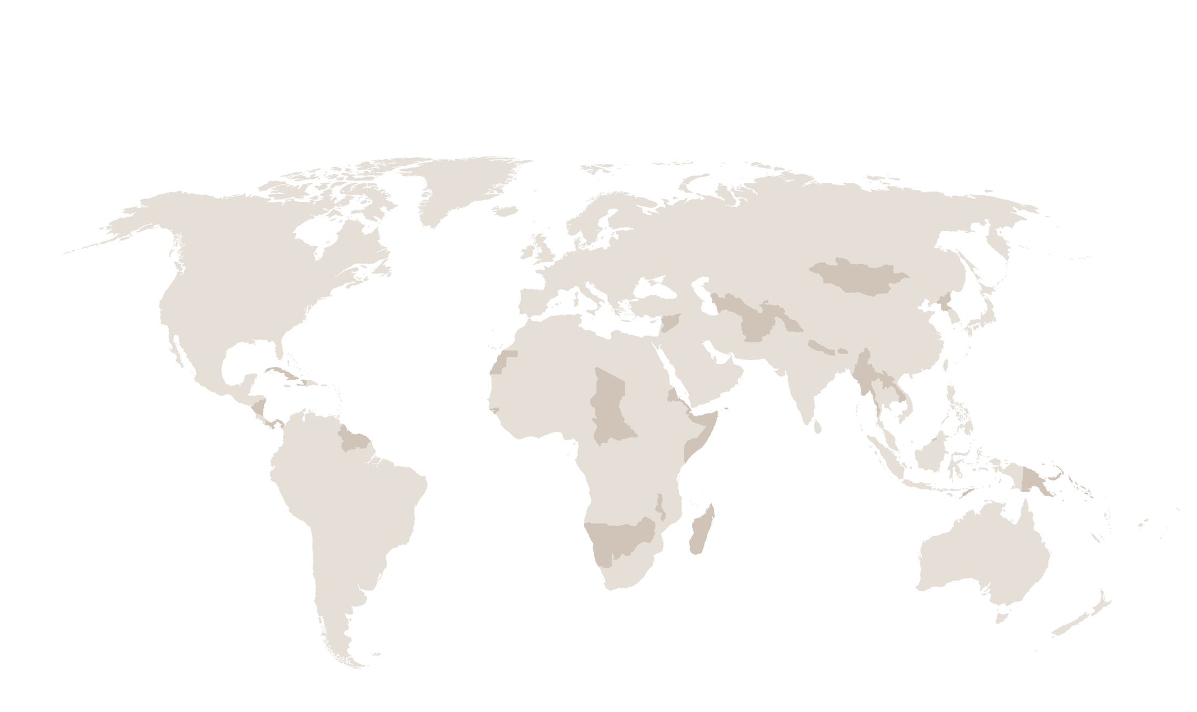
Latam acquisitions improve geographical balance 2012 Fertilizer deliveries, Yara + Bunge Brazil + Abocol Group
Europe
9.6 mill. tons
North America
3.0 mill. tons
Asia
1.9 mill. tons
OFD
1.1 mill. tons
Africa
1.2 mill. tons
Bunge
4.6 mill. tons
Latin America
4.7 mill. tons
Oceania
0.3 mill. tons

Slide 6
Delivering growth in Latin America: with Bunge acquisition – and OFD Group
Value-added N production in Colombia (Abocol)
Distribution companies across Latin America
FTEs 2012: 959
USD million | 2010 | 2011 | 2012
Net Revenues | 540 | 820 | 796
EBITDA | 47 | 64 | 35
K tons | 2010 | 2011 | 2012
Total net volumes | 1,030 | 1,261 | 1,131
Notes:
By acquiring the Abocol Group, Yara will secure a value-added nitrogen production company situated in Latin America, in addition to several distribution assets which will increase Yara’s market presence across Latin America.

Slide 7
Integration and synergy harvest on track
Total USD 50 million
Operations: Plant & overhead optimization Storage cost reduction Equipment leasing contracts
Local logistics & procurement : Gains in scale Optimization of product flows
Supply: Maritime freight: larger vessels, fewer stops, more FOB Discounts / rebates
Other: Commercial optimization IT cost savings
Legal merge effective 1 November; joint operation running well and minimum annual synergies of USD 50 million to be realised by 2014
Notes:
The integration of Bunge Fertilizer and Yara Brazil is well underway, with the legal merge already completed as of 1 Novembers, and operations fully merged by year end. Minimum annual synergies of USD 50 million will be realized from 2014.

Slide 8
Value-added products drive commercial synergies through increased footprint
Brazil value-added product deliveries (kilotons)
Significant growth track record for Yara value-added fertilizer products exported from our European production facilities to Brazil
The enlarged scale of the operation will enable us to extend the reach of our value-added portfolio
Notes:
The Bunge Fertilizer acquisition will also increase Yara’s Brazilian footprint for value-added product sales. Low cost and scale in operations will enable Downstream to increase its reach for value-added products.
Yara is targeing more than 1 million tonnes of value-added product sales in Brazil in 2014, mainly compound NPKs, nitrates and calcium nitrate.

Slide 9
Bunge: increased scale drives maritime logistics savings
1 USD/t improvement on shipping = 6 MUSD
Other
Nitrates
6 million tons
NPK
Urea
Phosphate
MOP
Pre Bunge
Post Bunge
Notes:
The Bunge Fertilizer acquisition more than doubles Yara’s fertilizer shipments to the country, creating increased scale within maritime logistics, through larger shipments, trade flow optimization and other scale benefits.
The optimization and synergy harvest linked to the Bunge Fertilizer acquisition, with increased scale within raw material purchasing and maritime logistics, are the current key priority for Yara’s Supply & Trade function.

Slide 10
Continued strong price incentives necessary to match consumption growth
Grain consumption and production
Days of consumption in stocks
Source: USDA, November 2013
Notes:
The trend growth for global grain consumption is 2% per year. Unless further depletion of already low stocks, production need to set new records going forward.
Demand prospects for fertilizer demand are very solid.

Slide 11
Chinese urea production and exports ahead of last year
Chinese urea production
Domestic urea balance
13/14
12/13
11/12
-4.0%
Source: BOABC, CFMW
Jul-Oct 12/13
Jul-Oct 13/14
Notes:
Urea production in China has still been gaining year on year, but has recently slowed. Capacity is increasing, but curtailments are reducing the rate of capacity utilization.
Since July, exports increased more than production, reducing supply to the domestic market somewhat.

Slide 12
India nitrogen consumption outpaces capacity Urea supply & demand 2005-2012
1,4%
4,6%
30,5
31,0
26,8
26,5
26,5
28,0
25,2
22,6
21,8
22,0
22,0
22,2
22,6
22,7
23,0
20,8
2005
2006
2007
2008
2009
2010
2011
2012
Production
Consumption
New subsidy policy aimed at increasing production – but limited gas available
Notes:
Since the increase in production to 22 million tons in 2011, Indian urea production has been stable.
Consumption has continued to develop strongly, increasing the need for imports. India is now clearly the top importer of urea in the world, needing 8 million tons a year, or more if the trend continues.

Slide 13
Projected nitrogen capacity additions outside China in line with historical consumption growth
Year | Driving regions | Urea capacity growth relative to nitrogen capacity
 | Excluding China | Excluding China
2013 | Qatar 19% Algeria 17% | 1.4% (2.5%)
2014 | Iran 23% India 21% | 1.8% (1.8%)
2015 | Algeria 25% Iran 13% | 3.5% (2.2%)
2016 | USA 32% Indonesia 14% | 3.2%
2017 | USA 31% Iraq 30% | 1.5%
Gross annual addition 2013-2017 |  | ~2.3%
Assumed annual closures |  | ~0.5%
Net annual addition 2011-2015 |  | ~1.8%
Trend consumption growth from 2002 |  | 2.1%
Source: Fertecon urea update August 2013 (February update in brackets). Consumption data source is IFA.
Notes:
According to Fertecon estimates, quite a lot of new capacity is scheduled for completion during 2015 and 2016.
It is worth noting that empirical evidence suggest that only around 1/3 of planned capacity actually manage to be ready the year it was planned. And several of the relevant projects have concerns attached to them, with Algeria, Bangladesh, Egypt, Iran, Nigeria as examples. Also in USA, the tempo may be reduced compared to the ambitious schedule predicted.

Slide 14
Summary of scenario price assumptions
USD/t
Urea price fob China
440
420
USD/RMB 6.23
USD/RMB 6.23
USD/RMB 6.10
USD/RMB 6.10
400
380
360
360
340
335
22
320
56
320
7
310
300
24
24
7
280
33
33
260
289
289
270
270
0
CMD 12 Assumed cost
CMD 12 Realized export tax
CMD 13 Assumed cost
CMD 13 High tax
Tax
Logistics
Cost
Notes:
The scenario based on assumed Chinese cost follows the same logic as the one presented in Yara’s 2012 Capital Markets Day, with updated assumptions for cost, logistics and tax.
A domestic price / cost ex-works at RMB 1,650/t is assumed, with logistics cost of RMB 200/t added. For export tax, the expected (but not officially confirmed at the time of writing) 2014 regime is used, with assumptions as follows:
- RMB 50/t tax in the low tax period (July through October, as in 2013)
- 15% tax + RMB 50/t for the rest of the year
The ex-works assumption has come down due to lower coal prices, partly offset by the appreciation of RMB versus the USD. Logistics cost have been revised upwards, and could potentially increase further with the removal of subsidies.

Slide 15
Earnings scenarios
NOK per share
25
54
25
10
29
3
-2
-7
20
1
19
3
Swing CMD12
Volume
Phosphate margins
Commodity N margins
Value-added margins
Currency
Swing CMD 13 assumed cost
Price/Margin
Swing CMD 13 assumed high tax
Price/margin
Demand driven
Notes:
The demand driven scenario illustrates the effect of a demand driven margin of USD 150 on top of the average price in the two swing scenarios.

Slide 16
Chinese urea prices – the relevant floor prices?
Source: China Fertilizer Market Week, International publications
Notes:
Over the last few years, China has been the major swing supplier to the world market. So domestic urea prices in China, plus the restrictions in place for exports, correlate strongly with global urea pricing.
Given current coal prices, urea prices in China are likely close to the floor, as the highest cost producers in China are struggling to operate.

Slide 17
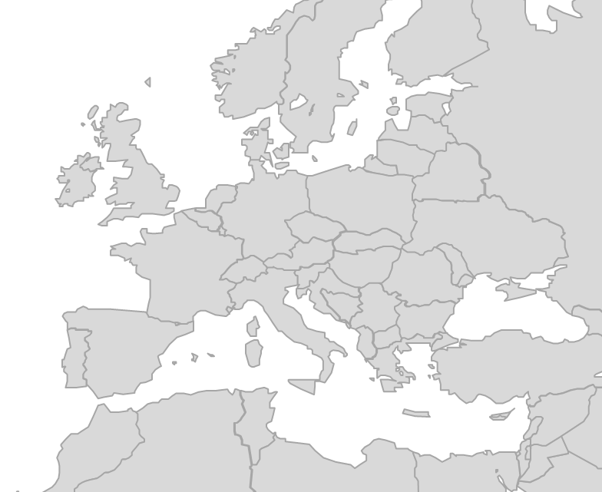
Flexible structure gives downside protection Costs are ~90% variable, and 90% of nitrate /NPK plants are flexible
Yara European ammonia production
Nitrate and NPK plant locations
Available
Integrated
Flexible
NH3 production
Urea/UAN
Tertre Nitrates
Nitrates
NPKs
IND off-take
Short position
Notes:
Although nitrate and NPK production technically does not need to be integrated with ammonia production, for a plant to have ammonia sourcing flexibility in practice, it must be in a location which allows ammonia import (normally with port access).
With the exception of the Tertre nitrate plant, all of Yara’s European nitrate and NPK plants have logistical access to ammonia sourcing.

Slide 18
Growth is progressing and pipeline is strong
Growth in own-produced and JV volumes
Executed & pipeline projects so far are mainly plant expansions
Bunge production tons are limited, but acquisition gives significant footprint for future upstream growth
Further investments under evaluation
+8.0
32.5
24.5
2.4
0.9
Commodity:
Qafco V & VI: 0.7
Sluiskil: 0.5
Bunge: 0.3
Value-added:
OFD 0.5
Porsgrunn 0.3
Pilbara TAN 0.2
Commodity:
BASF 0.4*
Value-added:
Porsgrunn 0.3
Uusikaupunki 0.2
2010
Executed / in execution
Close to approval
Pipeline / remaining
Target
Notes:
As previously communicated, Yara sees profitable market opportunities to target an 8 million ton increase in own-produced and joint venture product sales. Yara has made significant progress towards this target during 2012 and 2013.

Slide 19
Cash return policy 40-45% of net income, minimum 30% dividend
Numbers reflect cash returns executed in a calendar year relative to net income the year before. 2005 number reflects buy-backs and redemptions carried out in 2004 and 2005.

Slide 20
Maintaining BBB credit rating and ability to execute medium-size M&A
Debt / EBITDA at “low swing“ earnings
Maintaining BBB credit rating is key to growth financing ability
Yara wants ability to execute medium-size M&A (up to ~USD 2 bn targets)
Ability to execute M&A during cyclical lows is of high importance
More cash to shareholders in the event of stronger earnings and / or limited growth execution
BBB rating requirement: 2x

Slide 21
Prospects 2014
Continued strong demand fundamentals and value-added premiums
Chinese domestic urea and coal price development likely to influence commodity nitrogen fertilizer markets
Limited nitrogen capacity growth outside China
Yara’s value-added products and differentiated business create impact and provide sustainable strong returns

Slide 22
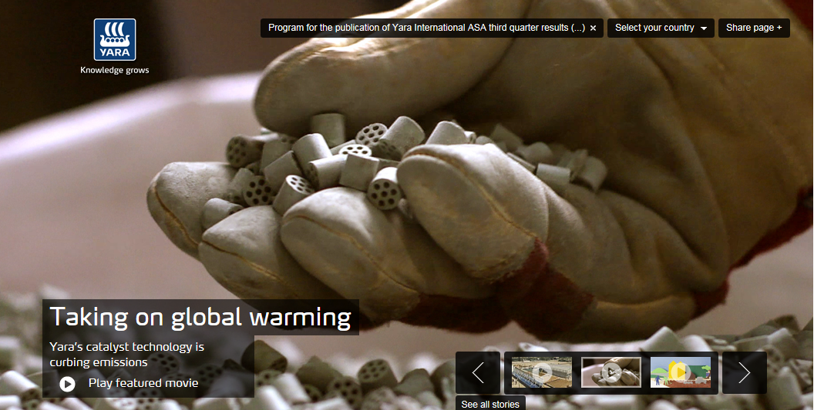
More information can be found on www.yara.com
NOT UPDATED

Slide 23
Integrated business model provides scale, flexibility and end-to-end presence
Supply & Trade
Upstream
Downstream
Industrial
Scale advantages
+
Unique flexibility
+
Unrivalled presence
Notes:
11/29/2013
22
Our strategy is closely connected to our unique business model. With global optimization at its’ core, the model builds upon Yara’s scale advantage, extensive flexibility and unrivalled presence.
Upstream includes Yara’s large-scale ammonia and fertilizer plants worldwide and phosphate mines, composing the backbone of Yara’s production system.
Downstream consists of Yara’s worldwide marketing organization and global distribution network for fertilizer products and agronomic solutions, providing a unique global presence.
Industrial provides environmental and industrial solutions, developing chemical products and industrial gases for non-fertilizer market segments, exploiting the company’s industry base.
Supply & trade is responsible for global optimization of energy and raw materials purchases, ammonia trade and shipping, maritime logistics, third-party sourcing, and feed phosphate.

Slide 24
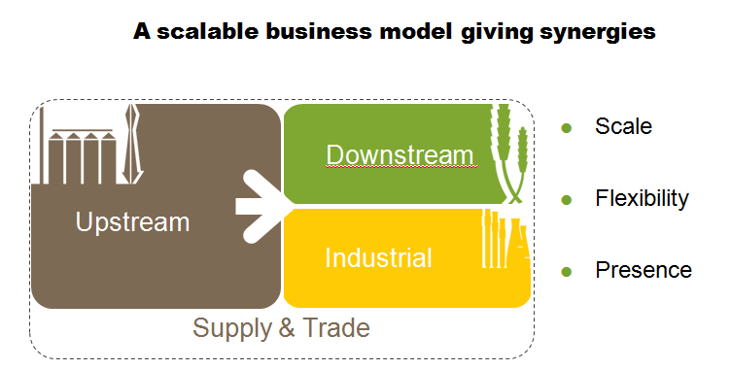
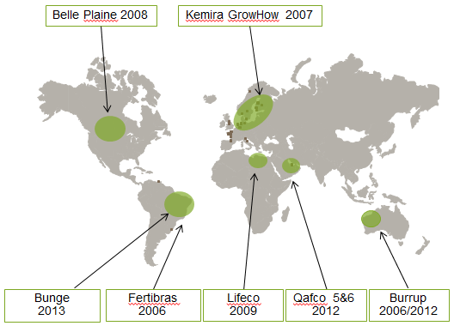
Targeting continued profitable growth
Yara CROGI
A scalable business model giving synergies
Industry-leading acquisition track-record
Valuation and capital discipline
In acquisitions Yara looks for:
Relative synergies compared to alternative buyers
Distressed sellers
Our cycle view compared to seller & alternative buyers
Capital and valuation discipline demonstrated
Grain, fertilizer and gas outlook has recently improved increasing nitrogen asset values

Slide 25
Multiple growth options; de-bottlenecking and regional M&A currently most attractive
1
Reconfiguration/expansion at existing sites, potential for increased NPKs, nitrates and CN
2
Pursue medium-size/regional M&A, likely highest probability of success in current environment
3
Secure longer term partnerships with access to low cost raw materials for potential new builds

Slide 26
Yara sensitivities
 | Operating Income USD million | EBITDA USD million | EPS* USD
Urea sensitivity +100 USD/t | 937 | 1,103 | 3.1
…of which pure Urea | 285 | 416 | 1.2
…of which Nitrates | 367 | 393 | 1.1
…of which NPK | 211 | 220 | 0.6
Nitrate premium +50 USD/t | 468 | 498 | 1.4
…of which pure Nitrates | 289 | 311 | 0.9
Hub gas Europe + 1 USD/MMBtu | (145) | (162) | (0.4)
Ammonia + 100 USD/t | 30 | 86 | 0.2
Phos rock + 50 USD/t | 50 | 50 | 0.1
Hub gas North Am + 1 USD/MMBtu | (26) | (26) | (0.1)
Crude oil + 10 USD/brl | (15) | (15) | (0.0)
Currency NOK per USD +10%** | 30 | 25 | 0.1
Currency EUR per USD +10% | 115 | 95 | 0.2
Currency BRL per USD +10% | 30 | 25 | 0.1
*Assuming 25% marginal tax rate on underlying business and 277.6 million shares
** *e.g. If NOK per USD depreciate 10% from 6 to 6.60 NOK
Sensitivities assume stable value-added margins and no inter-correlation between factors
Notes:
The basis for the nitrogen sensitivity is Yara’s nitrogen capacity expressed in urea equivalents. The EBITDA sensitivity reflects taxation and elements of urea-linked gas contracts in some of the associated companies.
The nitrate premium sensitivity is based on the part of our capacity that carries a premium over urea. This includes all nitrates and all NPKs produced in Yara’s European NPK plants. The reference for the sensitivity is the CAN price, and shows the effect of a 50 USD increase in the nitrate premium.
The sensitivities are long-term (>1 year) and ignore any correlation between the different parameters. For example, even though commodity prices in the past have often increased when the US dollar has weakened, this is not taken into account in the USD sensitivity.
Further explanation on how to use the sensitivities can be found at www.yara.com

Slide 27
Price and currency assumptions in scenarios
 | Last 4 quarters | 5-year avg. to 30 Sep 13 | Chinese swing* |  | Demand-driven**
 |  |  | Low | High
Ammonia fob Black Sea (USD/t) | 546 | 424 | 400 | 400 | 475
Urea prilled fob Black Sea (USD/t) | 365 | 340 | 300 | 350 | 475
Nitrate premium, USD/t | 84 | 85 | 85 | 85 | 85
Phos rock fob North Africa (USD/t) | 162 | 160 | 125 | 125 | 125
DAP fob USG (USD/t) | 496 | 499 | 360 | 360 | 360
Zeebrugge natural gas (USD/MMBtu) | 10.3 | 8.0 | 10.4 | 10.4 | 10.4
Henry hub natural gas (USD/MMBtu) | 3.6 | 3.9 | 3.7 | 3.7 | 3.7
Yara’s European energy price (USD/MMBtu) | 11.0 | 9.5 | 10.7 | 10.7 | 10.7
Brent blend crude oil price (USD/bbl) | 103 | 88 | 105 | 105 | 105
NOK/USD | 5.8 | 6.0 | 6.10 | 6.10 | 6.10
EUR/USD | 1.31 | 1.34 | 1.35 | 1.35 | 1.35
BRL/USD | 2.08 | 1.91 | 2.30 | 2.30 | 2.30
*Energy prices are forward prices as of 9 November
** Given example to illustrate effect of urea price USD 150 per ton above average of the two swing scenarios
Notes:
The “5-year average” scenario assumes fertilizer prices, energy prices and currency rates equal to the average over the last five years.
Nitrate premiums over urea are assumed to be 85 USD/t, equal to the 5-year average. The European energy price is based on forward prices with a discount of USD 0.5 per MMBtu for the hub-based capacity.
In the demand-driven scenario, urea prices are assumed USD 150 above the average of the two swing scenarios.
Phosphate rock and DAP prices reflect current price levels, influenced by the weak demand situation in India.

Slide 28
Simplified P&Ls for scenarios
NOK millions | Last 4 quarters | 5-year avg. to 30 Sep 13²⁾ | Chinese swing |  | Demand-driven
 |  |  | Low | High
EBITDA¹⁾ | 14,800 | 14,800 | 11,300 | 14,700 | 23,500
Depreciation | -3,400 | -3,600 | -3,600 | -3,600 | -3,600
Interest expense | -900 | -800 | -800 | -800 | -800
Income before tax | 10,500 | 10,400 | 6,900 | 10,300 | 19,100
Tax | -2,000 | -2,200 | -1,400 | -2,100 | -4,000
Minorities | -250 | -250 | -200 | -200 | -300
Net income | 8,250 | 7,950 | 5,300 | 8,000 | 14,800
Number of shares (millions) | 279.7 | 276.6 | 276.6 | 276.6 | 276.6
Earnings per share (NOK) | 29 | 29 | 19 | 29 | 54
¹⁾ Including interest income, assumed in line with last 4 quarters in all scenarios.
²⁾ Not historical earnings, but estimated earnings for today’s Yara business, using 5-year average price conditions.
Notes:
The cash flows and earnings in the various scenarios exclude special items like foreign exchange effects, position gains etc.
The basis is today’s activities but with different price scenarios.
The 5-year average scenario is based on today’s business but using average prices for the last five years.

Slide 29
Nitrates are more efficient than urea
Urea (CON₂H₄)
Ammonium (NH₄⁺)
Nitrate (NO₃⁻)
Urea-N needs to be converted into ammonium-N before it is plant available.
Ammonium-N is fixed onto clay minerals in the soil and therefore immobile. The plant roots have to grow actively towards the nutrient.
Nitrate-N is always dissolved in the soil water and is transported passively together with the water into the plant root. Thus, nitrate is rapidly effective.
Notes:
Nitrate is immediately and easily taken up by plants
Ammonia (NH3) is the basis for all nitrogen fertilizers and it contains the highest amount of nitrogen (82%). Ammonia can be applied directly to the soil, but for several reasons, including environmental, it is common to further process ammonia into, e.g., urea or nitrates before application. If ammonia is applied directly to the soil, it must be converted to ammonium (NH4) and nitrate before plants can use it as a source of nitrogen.
While ammonium and nitrate are readily available to plants, urea first needs to be transformed to ammonium and then to nitrate.
The transformation process is dependent upon many environmental and biological factors. E.g., under low temperatures and low pH (as seen in Europe), urea transformation is slow and difficult to predict with resulting nitrogen and efficiency losses. Nitrates, in comparison, are readily absorbed by the plants with minimum losses. Therefore, nitrates are widely regarded as a quality nitrogen fertilizer for European agricultural conditions. This is reflected in their large market share.

Slide 30
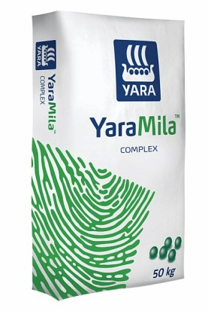
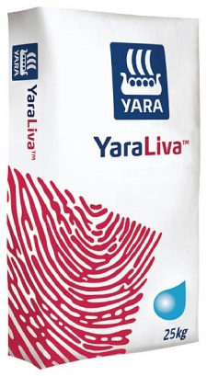
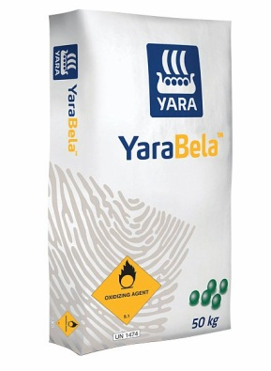
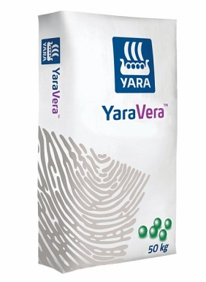
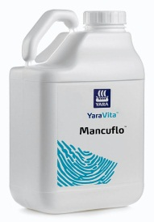
Yara’s product portfolio is continuously improved to meet changing customer needs
Yara has over many years developed a wide, differentiated product offering
Continuous development of both new and improved differentiated products key to maintaining earnings in competitive global market
We will also seek out niche businesses for acquisition to help achieve this objective
Notes:
Yara’s offers a complete portfolio of fertilizer products to optimize quality and yields for a range of crops. A key focus area for Yara is to continuously develop and improve differentiated products to meet changing customer needs and maintain its competitive edge.

Slide 31
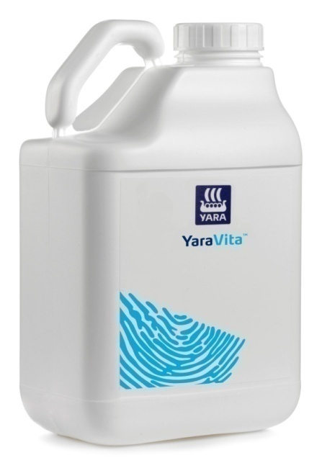
YaraVita: a specialty product success story
YaraVita revenues, USD millions
110
CAGR
+17%
78
81
68
58
2009/2010
2010/2011
2011/2012
2012/2013
BP 2014
Notes:
YaraVita is Yara’s micro nutrient/foliar specialty range from, a business acquired in 2006 enabling Yara to offer a complete plant nutrition portfolio. Revenues have increased with a compound average growth rate of 17% since 2009.

Slide 32
YaraVita Procote: Cost effective vehicle for differentiation and better agronomic efficiency
Uses YaraVita micronutrient expertise in innovative new fertilizer coating products
Allows wider differentiation within Downstream with minimal complexity
Very strong agronomic and material handling feedback in test markets
Expect approximately 2% of Yara’s fertilizer with Procote in 2014
Fertilizer
Micronutrient coating
Notes:
Procote is a technique for application of a micronutrient coating to standard fertilizer, achieving:
Greater uniformity in Micronutrient distribution
Reduced dust in the granules
Differentiation of offering

Slide 33
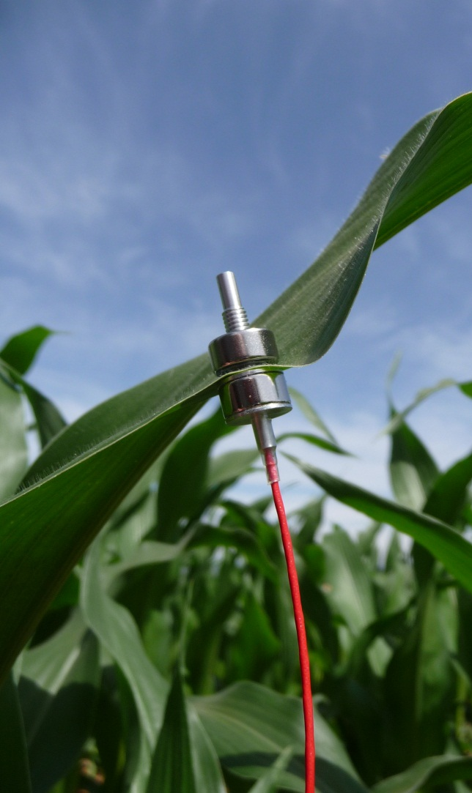
Yara acquires ZIM crop sensor technology to increase water use efficiency
Agriculture consumes 70% of global freshwater resources; increased water scarcity drives demand for new agricultural solutions
Crop sensor technology can improve nutrient and water use efficiency in agriculture. The Yara N-sensor already has a leading role in precise nutrient application
ZIM Plant Technology GmbH water sensor technology: the most advanced and reliable crop measuring technology to monitor the water status of the crop
ZIM technology combined with Yara Crop Nutrition programs can deliver:
Yield increase of 5-15%
Water use reduction of 20-30%
Crop quality improvement
Yara’s ambition is to be the leading supplier of crop nutrition solutions for water scarce agriculture
Notes:
The German water sensor company ZIM Plant Technology sells the most advanced and reliable crop water sensor technology available today, used in high-precision irrigation systems to improve yields and water use efficiency.
Yara will incorporate ZIM knowledge and technology into its existing Crop Nutrition solutions, providing a valuable add-on for our offering to irrigated farming. This clearly improves Yara's leadership position within the growing fertigation segment.
The farmers' motivation to purchase the technology is reduced water consumption, increased yields and improved crop quality. Integrating the water precision tool with Yara's knowledge on precise application of water soluble and liquid fertilizer (fertigation) will multiply the market potential for both.

Slide 34
We work in a systematic manner to identify the crop segments with highest value potential
Strawberry
Apples
Oranges
Coffee
Potato
Maize
Wheat
Crop Value Index is sales price of the crop divided by cost of fertilizers and is used as an indicator for the profitability of an investment in fertilizer to produce that crop
Notes:
To identify what crop segments to focus our marketing efforts around, we work in a systematic manner. First we look at the crop value index in combination with the acreage of that crop. Crop value index gives an indication of the value of the crop compared to the fertilizer input. Typical cash crops will have a high CVI. The acreage is important to ensure we work on crops with a significant overall potential. This picture we match with our knowledge on where Yara’s product portfolio have a significant benefit in terms of increased quality and yield. E.g. beans have a relative high CVI of 57 and 27 million of acreage but need for nitrogen is limited and therefore is not a focus crop.

Slide 35
Farmer yield benefits justify nitrate premium
Nitrate premium above urea
Value above ammonia
Value above gas
Yara EU gas cost *20

Slide 36
Stable NPK premiums
Value above
raw material
Margin above blend cost
Urea, fob Black sea
NH3, fob Black Sea *0.22
MOP, cfr NWE
Rock, fob NA *1.4
DAP, fob Morocco

Slide 37
Supply & Trade – global optimization
Biggest industrial buyer of natural gas in Europe
Third single biggest buyer of P&K globally
Significant market
share on trade
Gas consumption, MMBtu
2012 raw material purchases (mt)
2012 annual trade volumes (mt)
185
5.3
21.3
43
115
3.0
2.8
19
11
25
3.3
23%
9%
30%
Europe
Canada
RoW
Potash, MOP
Phosphate rock*
Ammonia
Urea
NPK
= BASF JV
China
India
Yara incl. Bunge
Yara share
*72 BPL
Notes:
Supply & Trade plays an important role in Yara as it is responsible for optimizing the sourcing of all the key input factors into Yara’s global production and downstream systems. In addition, the Supply & Trade organization is responsible for a sizable trading activity.
Yara is the biggest industrial buyer of natural gas in Europe, and the third single biggest buyer of phosphate and potash globally, providing scale and potential to source these raw materials more competitively than the average non-integrated NPK producer or farmer.

Slide 38
Leading global position in ammonia trade
Europe
6.1
4.9
Yara-operated ammonia fleet unrivalled giving scale and flexibility
Operate 18 ships
Total shipping capacity of ~260 kilotons
5.1
Available
Demand
Americas
2.3
2.5
Middle East / Africa
Asia
1.5
1.1
0.7
Available
Demand
Available
Demand
Available
Demand
Australia
0.8
BASF JV
0.3
Marketing agreement
Yara production
Available
Demand
External sales
Upgrade
Notes:
Yara's ammonia footprint covers the world's most important regions, Americas, Europe/Med and Asia. Although Yara is net long overall, we import more than 1 million tons annually into Europe to serve both own nitrate and NPK plants and end-user sales in the Industrial segment.
Our established position requires a dedicated LPG fleet to meet transport obligations of 4 - 5 million tons of ammonia on an annual basis. This presence, operating 18 vessels at any given time, provides Yara a unique position to arbitrage intra-regional imbalances and external trade opportunities without impacting its overall risk profile.
.

Slide 39
Yara is short on ammonia in Europe
Million tons
Consumption
4.9
Available
1.6
Integrated
Flexible
0.3
2.1
1.5
0.5
-1.1
NH3 production
Urea/UAN
Tertre Nitrates
Nitrates
NPKs
IND off-take
Short position
Notes:
The flexibility of Yara’s ammonia position in Europe is significant due to:
most of the ammonia is upgraded to nitrate and NPK. Unlike urea, nitrate and NPK plants can import ammonia since the production processes are non-integrated.
Yara has a net short ammonia position in Europe

Slide 40
Yara’s flexible cost structure gives downside protection
Total cost base L4Q, NOK bn
Ammonia sourcing flexibility
72
Available
Fixed
7
Non flexible
Flexible
Variable
65
L4Q
1. Excluding depreciation, amortization and impairment
NH3 production
Urea/UAN
Tertre Nitrates
Nitrates
NPKs
IND off-take
Short position
Notes:
Most of Yara’s costs are variable. Combined with the significant sourcing flexibility of Yara’s European nitrate and NPK plants, this represents a significant downside protection.

Slide 41
Strong financial position supports growth
Net interest-bearing debt / equity ratio (end of period)
OFD

Slide 42
Earnings before interest, tax, depreciation and amortization (EBITDA)
NOK millions
EBITDA excluding special items
Annual
NOK millions | 15,315 | 18,163 | 16,970 | 11,432

Slide 43
Fertilizer volumes
Kilotons
2007
2008
2009
2010
2011
2012
2013

Slide 44
Yara 3Q fertilizer sales by market and product 2013: 5.9 million tons (2012: 5.0 million tons)
Kilotons

Slide 45
NPK and nitrate deliveries
Yara-produced NPK deliveries
Kilotons

Slide 46
Yara stocks, including Bunge Brazil from 3Q

Slide 47
Yara production volume*
Finished fertilizer and industrial products
Ammonia
2009
2010
2011
2012
* Including share of equity-accounted investees

Slide 48
Reduced exposure to oil and European gas
Yara’s geographic energy exposure
Yara’s feed-stock contract structure Europe
NAT GAS
NON GAS

Slide 49
Yara European gas cost closer to hub price
European energy cost
Spread between Yara and Zeebrugge
*Dotted lines denote forward prices as of 8 October 2013
Source: Yara, World Bank, Platts

Slide 50
Gas & oil cost
Yearly averages 2009 – 2010, quarterly averages for 2011-13 with forward prices* for 4Q13 and 1Q14
USD per MMBtu
*Dotted lines denote forward prices as of 8 October 2013
Source: Yara, World Bank, Platts

Slide 51
Currency exposure affecting P&L
At the beginning of the fourth quarter 2013
The US dollar debt generating p&l exposure was USD 1,100 million
Kept as hedge of future earnings and to finance inventories in emerging markets
Around 50% towards EUR and NOK, the rest towards emerging market currencies (mainly BRL)
The debt level in emerging markets will fluctuate with fertilizer seasons
Additional p&l exposure came from internal currency positions vs. NOK
Payables mainly EUR (460 million) and CAD (500 million)
Receivables mainly GBP (55 million) and AUD (40 million)
The effects of these positions correspond to offsetting translation effects in equity and the net economic effect for Yara is neutral

Slide 52
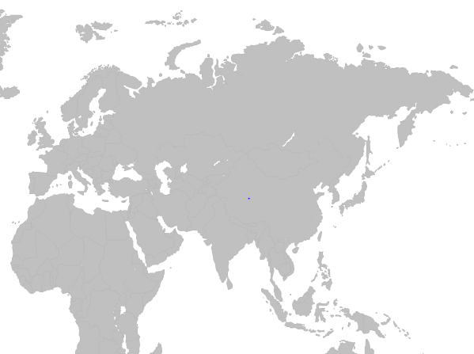
China swing scenario
RMB/mt = 6.1 * USD/mt
301
1,650
200 + 50
X+10
1,900 = 311
X
High export tax:
2185 (+15%) = 358
Notes:
This scenario is based on a domestic price ex. works at RMB 1,650/mt in main export provinces, like Shanxi and Shandong. A cost of RMB 200/mt is added to cover transport, bagging operations, port costs etc.
At the moment, market followers are expecting a RMB 50/t tax in the low tax period (July through October, as in 2013), and a 15% tax + RMB 50/t for the rest of the year. This scheme is not at the time of writing confirmed by Chinese officials.
But based on these assumptions, the export price fob China would logically fall in a USD 310-360 /mt range.
Assuming that Black Sea exporters chase business in India in competition with China, an extra roughly 10/mt is added to logistics from Black Sea. During 2H2013, Black Sea producers have not been very active in India, preferring other markets, or curtailing production.

Slide 53
European producer nitrate stocks
Source: Fertilizers Europe

Slide 54
Grain consumption growth stronger than population growth
US drought resulting in 2.9% drop in production, low stocks, demand rationing and spiking prices
3% drop in production
3% drop in production, low stocks, demand rationing and spiking prices
4% drop in production, low stocks, demand rationing and spiking prices
Source: US Department of Agriculture, United Nations

Slide 55
Higher meat consumption requires more feed grain
Significant potential for increasing
meat consumption in emerging countries
Feed grain multipliers for meat production
2X
4X
7X
Kg/capita/year
Kilograms of grain to produce 1kg of meat
Source: FAO

Slide 56
Large variations in yields across regions
Source: FAOSTAT. 2010

Slide 57
Chinese urea production and export balance
Chinese urea production
Domestic urea balance
13/14
12/13
11/12
-12.0%
Source: BOABC, CFMW
Jul-Aug 12/13
Jul-Aug 13/14

Slide 58
Key value drivers – quarterly averages
Source: Fertilizer Market Publications, CERA, World Bank, Norges Bank

Slide 59
10-year fertilizer prices – monthly averages
Source: Average of international publications
Average prices 2003 - 2013

